Slide 1
University Brands
Experiment
Samir Datta
Nishanth Nair
Kim Vignola
Kathleen Wang

Slide 2
Background
Rising cost of higher education
Prospective students are likely evaluating lower cost options
While private schools are out of reach for many, State Universities are also double the cost of local colleges

Slide 3
Research Question
What’s the difference in “out-of-the-gate” opportunities that a student can expect on LinkedIn for higher cost versus lower cost public institutions?

Slide 4
Null Hypothesis
Higher cost “brand” schools should lead to the same opportunities as non-brand schools

Slide 5
Experimental Design
Basic setup:
Job application through LinkedIn
Two sets of schools, one pair in East Coast, the other in West Coast
Factorial design to study interaction with resume strength
Making it real:
Four sets of phone numbers for linkedIn profiles
Four email addresses
Four LinkedIn profiles with real friend requests
Four sets of resumes with jobs, internships and school activities
Finding & applying jobs:
Searched for jobs on LinkedIn, expand area of search
Target entry level jobs
Removed listings that requires cover letter or long written answers
Staggered application, two phases
High level summary
2 X 2 design
Brand vs. non-brand
Weak vs. strong resume
4 candidates, similar names
Staggered application: e.g weak/brand & strong/nb
Two phases: phase 1 also served as pilot
Notes:
Basic setup:
With the null hypothesis defined, our team set out to design the experiment. We have decided to apply for jobs through LinkedIn because it is easy to find and apply for jobs. We have also decided to target entry level jobs because 1) it would be difficult to fake four resumes for senior level jobs and 2) there are not that many job postings targeting fresh graduates.
In order to make sure the difference between the schools are meaningful, we looked at rankings in engineer schools. We have decided to choose two areas NY and CA for our experiment because of the job opportunities in these two areas. Also, not many places have quality public colleges and we did not want to introduce the confounding factor of public vs private.
To make our results even more meaningful, we introduce two sets of resumes to test the interaction between school brand and resume strength. Our strong resume has more leadership and internship experience.
Making it real:
Of course we can’t submit different resumes to the same company under different names, so team worked hard to introduce four fake candidates and did our best to make them as real as possible:
So for our experiment, we have
Jake Roberts from UCLA
Jack Rogers from California State University, Long Beach
James Mason from The City University of New York
Jon Michaels from Rutgers University
All four of them have individual phone number, email account, linked in profile with real friends
Finding & applying jobs:
To make things easier, we utilize linkedin to find and apply jobs. At first we tried jobs for fresh graduates, because the impact of college brand is higher in that case. However, we soon find that there are not that many job openings targeting fresh grads on LinkedIn. As a result, we decided to focus on entry level jobs.
Since our focus is on college brand, we try to introduce less covariates so we did not apply to those companies that require long essay answers. With the main pieces in place, we started phase I of our experiment.
In phase I, our main goal is to find as much jobs as we can find in one setting and test out our process. We planned a phase II where we can expand the job search locations and address any potential issues that may come up in Phase I.

Slide 6
Experiment in Action
Total Applications | Non-Brand School |  | Brand School |  | Total # of Companies
 | Weak Resume | Strong Resume | Weak Resume | Strong Resume
East | 35 (20/15) | 35 (20/15) | 35 (20/15) | 35 (20/15) | 70
West | 40 (20/20) | 40 (20/20) | 40 (20/20) | 40 (20/20) | 80
Total | 150 |  | 150
Ready, set, apply!
On the same day, James Mason from CUNY City College applied to 20 jobs with a weak resume and another 20 with a strong resume. Jon Michaels from Rutgers applied to the another 40 jobs in the same manner
A few days later, James Mason applied to the jobs that Jon had applied to, but with a different resume strength
Repeated the same process two weeks later in phase 2
Notes:
How does it work:
With a 2X2 design, we want to test both college brand and resume strength, but we can’t send four resumes to one employer, and we can’t send two resumes of the same kind (e.g. we can’t send same weak resume with just the name and school differences) to the same employer.
What we did was to stagger our applications in each phase. On the same day, James Mason from CUNY City College applied to 20 jobs with a weak resume and another 20 with a strong resume. Jon Michaels from Rutgers applied to the another 40 jobs in the same manner
A few days later, James Mason applied to the jobs that Jon had applied to, but with a different resume strength
We repeated the same process two weeks later in phase 2.
This table summarizes our total application across phase one and phase 2. We applied to 150 jobs in total. 70 in East coast and 80 in westcoast. In the brackets we have two numbers, the first one are the number of jobs applied to in phase I, and the second phase II.

Slide 7
Other Challenges
Non compliance: Are the school differences noticed?
Attrition: Some job postings are closed, some never responded
Spillover: Will receiving one resume affect the outcome of the other? Can it be avoided using the staggering process
Excludability: Does our way of answering application questions have unintended effects?
Notes:
Even though our team carefully considered various experimental design issues, there are other challenges that we face in our design
Non compliance: Non compliance means unable to deliver our treatment for some reason. For us, it could be that the recruiters did not notice the school brand differences at all. We tackled this by making the school name visible at the top of our resumes.
Attrition: Attrition is a serious issue in our study. We cannot be sure if a recruiter did not reply to us because they looked at the resume and did not like us, or if they had already found a candidate and did not look at our resume. In our experiment we did have companies that we applied to with one candidate no longer accepting resumes when we applied with the second candidate a few days later. We removed these entries in our study and reweighted our data.
Spillover: We tried to staggle our applications by a few days so that the second resume that we sent should be less affected by the first. However, in reality, if companies are hiring only for 1 position, it is difficult to assume that one resume has absolutely no impact on the other.
Excludability: Each one of our team members took on the identity of one fake applicant. There are many times that we were required to provide short answers to questions. We tried to provide similar answers, but we can never be sure if our own personalities somehow flow through the job applications.
Overall, there are many details about designing an experiment that we have to be really careful of.
Next, Nishanth will talk about how we randomized the data.

Slide 8
How We Randomized
func <- function(company_id,company,stagger){
good <- company_id*company
weak <- company_id*(1-company)
stagger_good <- stagger[which(good > 0)]
stagger_weak <- stagger[which(weak > 0)]
return (data.frame(good = good[good != 0],
weak = weak[weak != 0],
stagger_good = stagger_good,
stagger_weak = stagger_weak))
}
user_1 = func(company_id,rand_company,rand_stagger)
user_2 = func(company_id, (1-rand_company), (1-rand_stagger))
Randomized in 2 Phases:
Phase I: 40 East, 40 West
Phase II: 30 East, 40 West
Randomize East and West independently
Measures Randomized:
Company assignment to applicants (good vs weak resumes)
Staggered Application
Conditions to be met:
Even split of good and weak resumes
Even split of stagger
A company cannot get both resumes from the same applicant
The same company cannot get both good or both weak resumes
The same company cannot get both applications at the same time, one should be staggered
Notes:
Nishanth

Slide 9
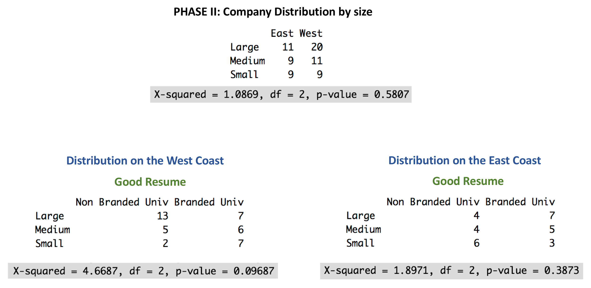
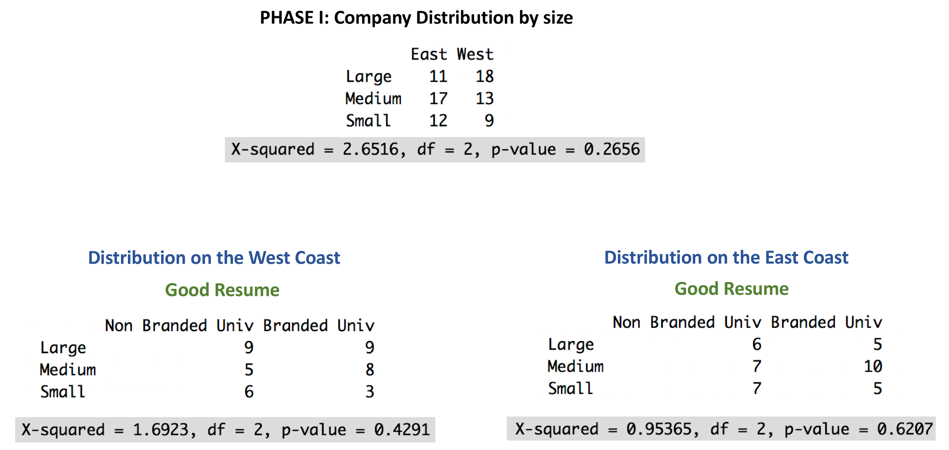
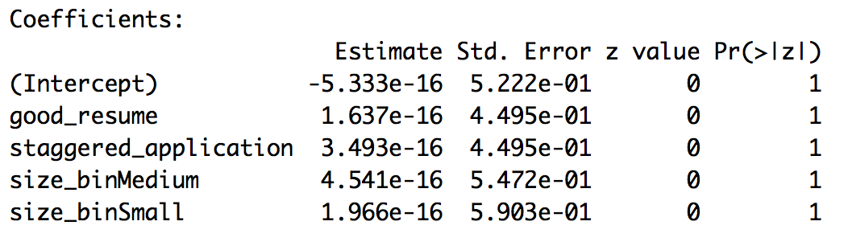
Randomization Analysis
Notes:
Nishanth

Slide 10
Final data set and variables
Application deemed valid if both candidates were able to apply to it
Attrition usually due to posting closing between applications or posting requiring materials we could not provide (references, etc)
Left with 210 total valid applications
Call_back (dependent variable)
0 if no response or explicit rejection
1 if contact was made regarding moving forward in any capacity
University_brand: brand or non-brand school?
Good_resume: weak or strong resume?
Coast: west or east?
Size_bin: Small (<100), Medium (100-999), or Large (1000+) size company?
Phase: first or second round of applications?
Staggered_application: for each posting, was this the first or second application sent?

Slide 11
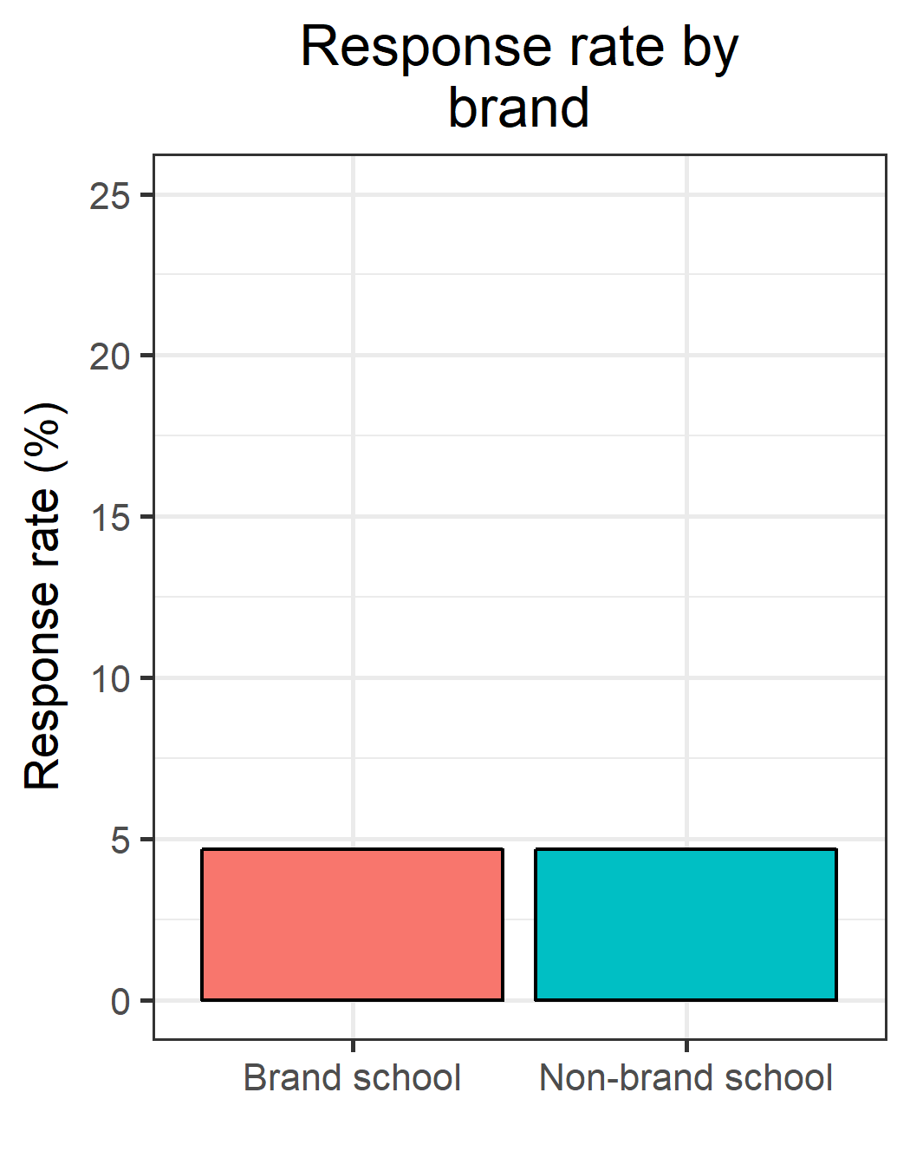
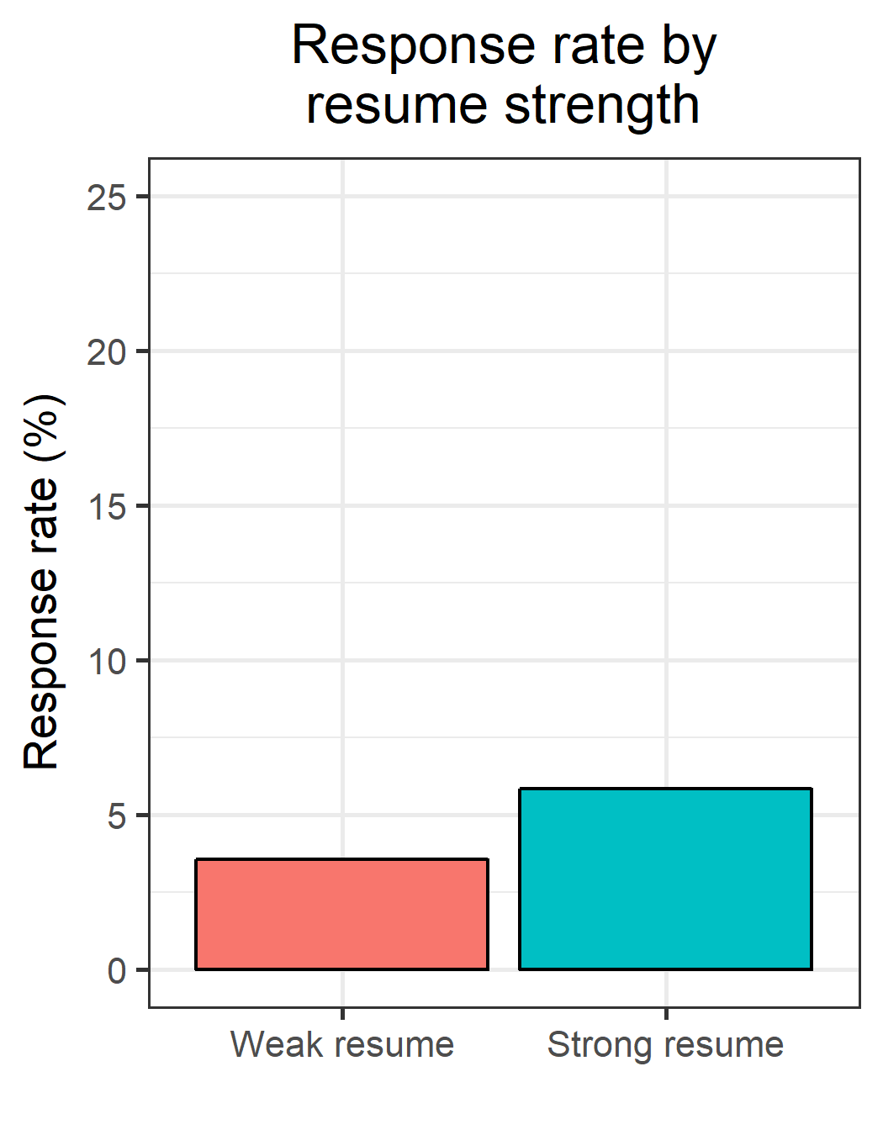
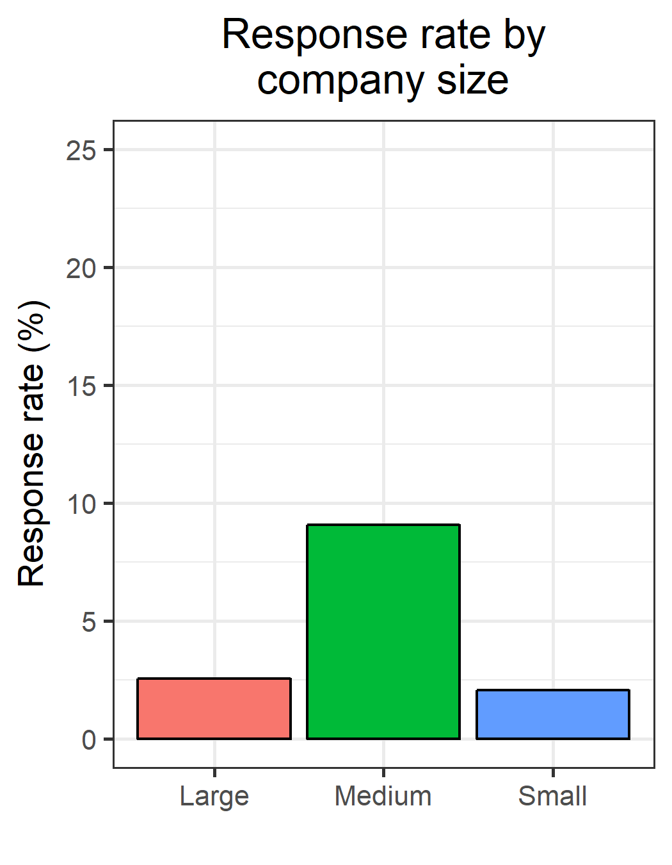
Main effects, part 1

Slide 12
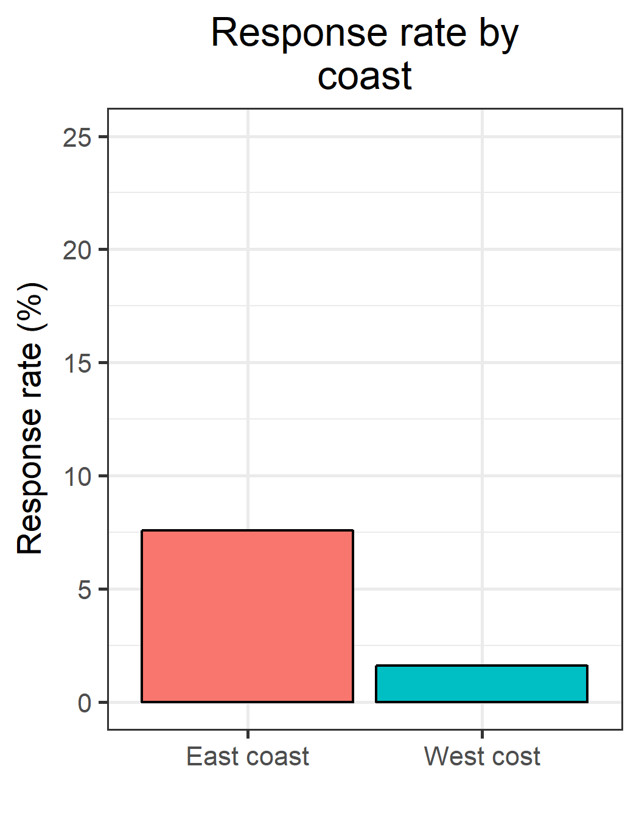
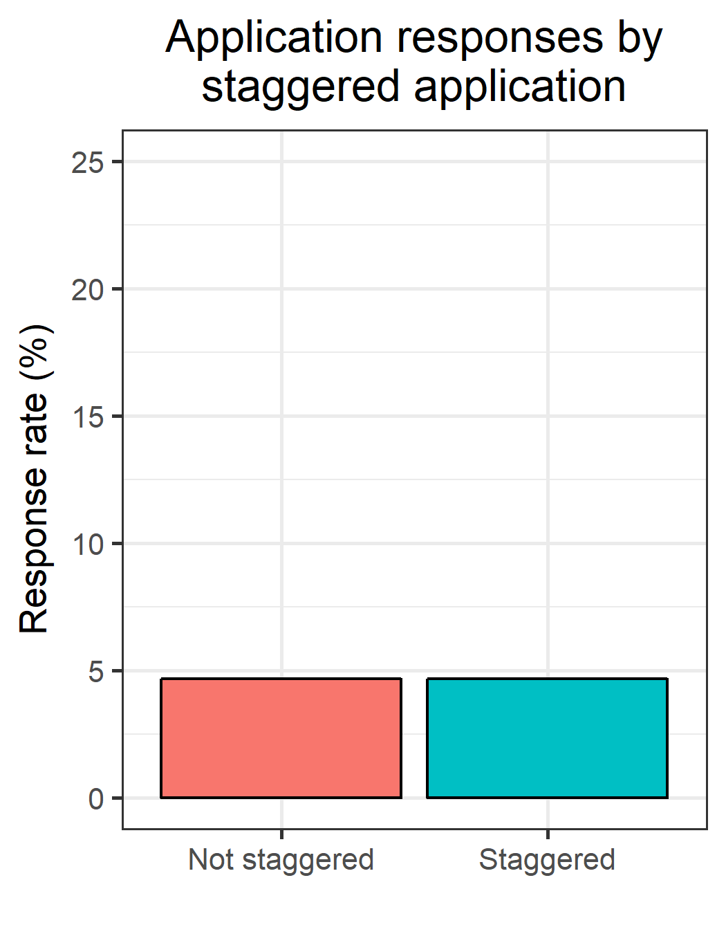

Main effects, part 2

Slide 13
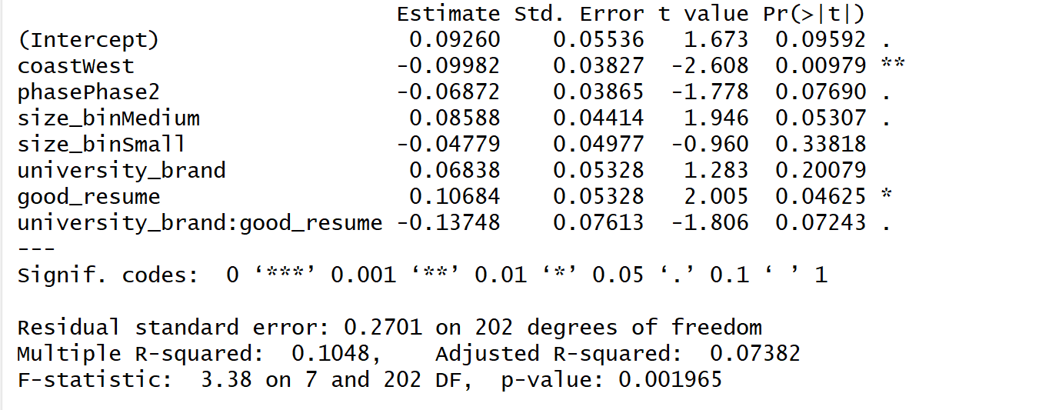
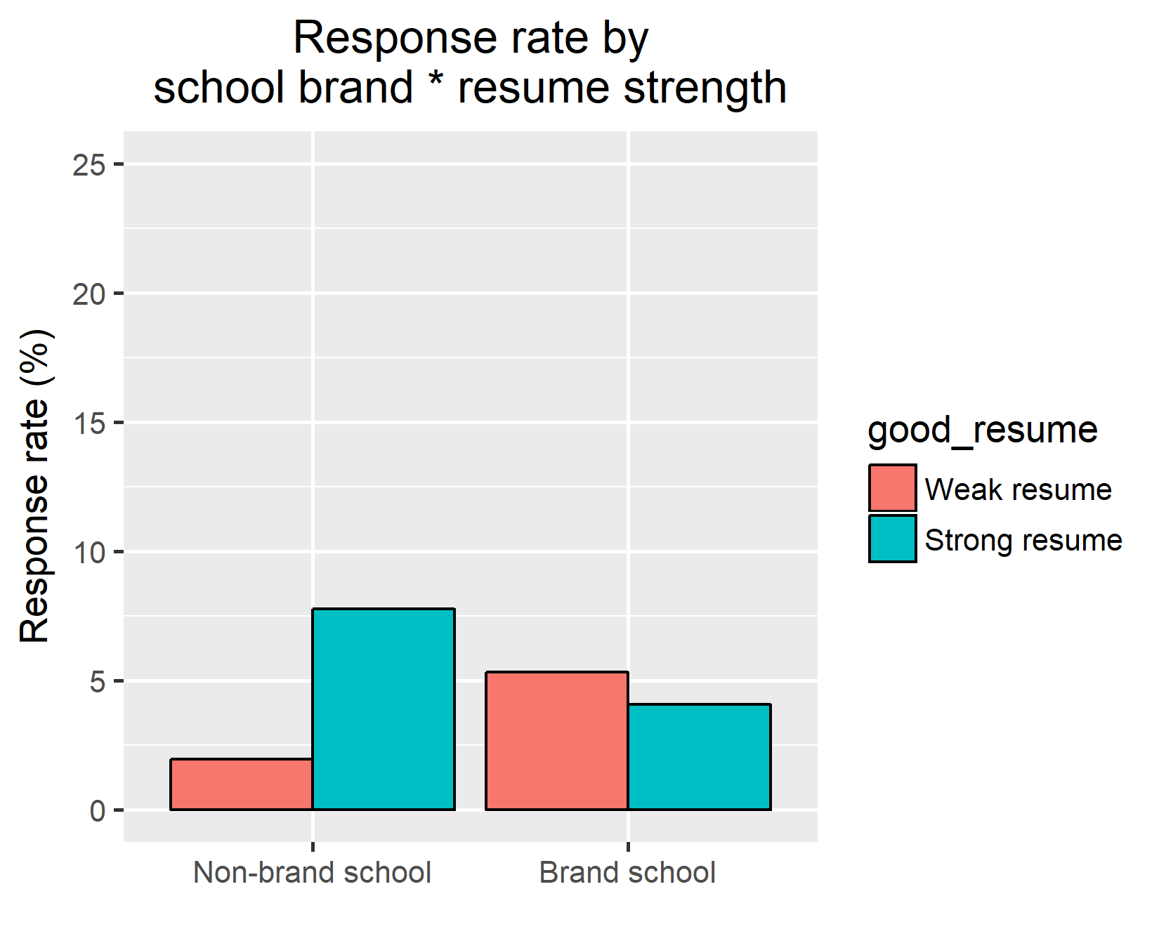
Final model
Final model: OLS linear regression with call back (0 = none/rejection, 1 = call back) as DV
For those with a weak resume, brand colleges 6.8% more likely to get call back (p = .20)
For those from a non-brand school, strong resume makes you 10.7% more likely to get call back (p = .047*)
Effect of a good resume 13.7% less for brand schools (p = .072)

Slide 14
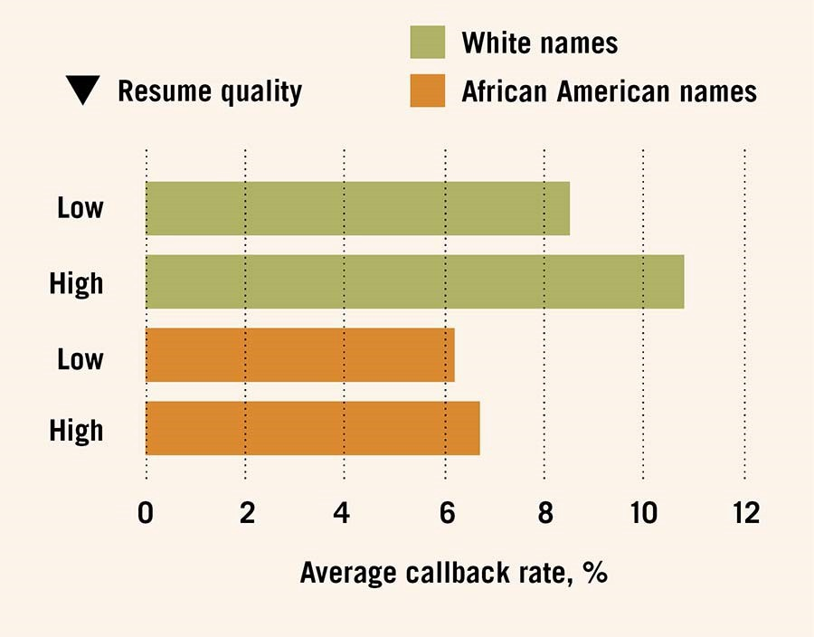
Our results vs. Bertrand and Mullainathan, 2004

Slide 15
Conclusions/Discussion
Summary
The data suggests, at a trend level, that a strong resume compensates for a weaker university
Caveats
Low power, significance due to sample size and response rates
Unwanted differences in making “strong” and “weak” resumes
“Ideal” future experiment
More applications!
Different levels of experience (undergrad vs. 2+ years)
Different times of the year
More believable LinkedIn profiles

